Slide 1
Sudoku
In React Native
Michael Rooplall

Slide 2
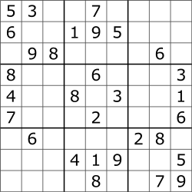
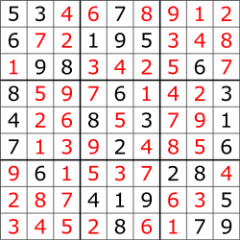
What is Sudoku
Sudoku is a logic based number-placement puzzle.
The objective is to fill a 9x9 grid with digits, so that each column, each row, and each 3x3 subgrid (or “block”) contain all the digits from 1 to 9, with no repetitions.
The puzzle begins partially completed depending on the difficulty, and it is up to the user to fill it in.
An example of a sudoku puzzle, and it’s solution

Slide 3
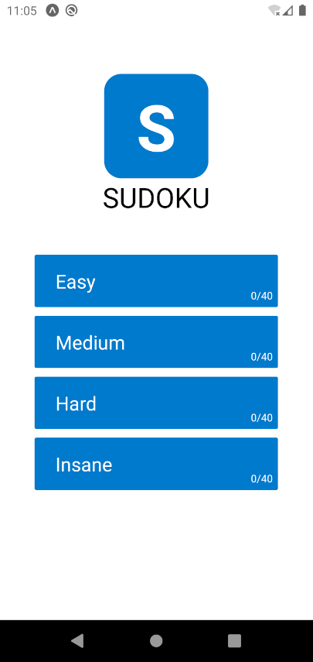
Home Screen
The Home screen shows the different difficulties available to play.
The number of levels a player has completed are also tracked.
A Flatlist component allowed me to dynamically create buttons from an array.

Slide 4
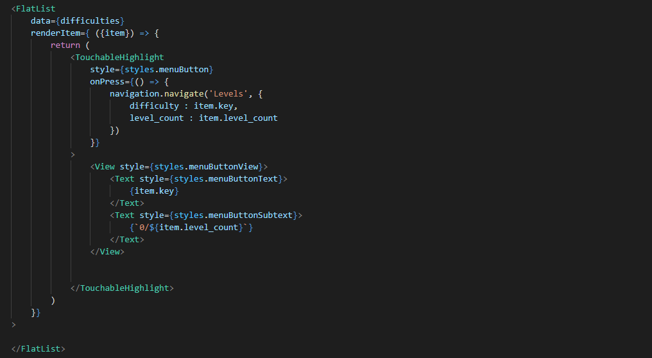
Passing an array of objects similar to [ {key : “Easy”, level_count : 40}, {key : “Medium”, level_count : 40}, {key : “Hard”, level_count : 40}, {key : “Insane”, level_count : 40} ] was used to generate the home screen using FlatList

Slide 5
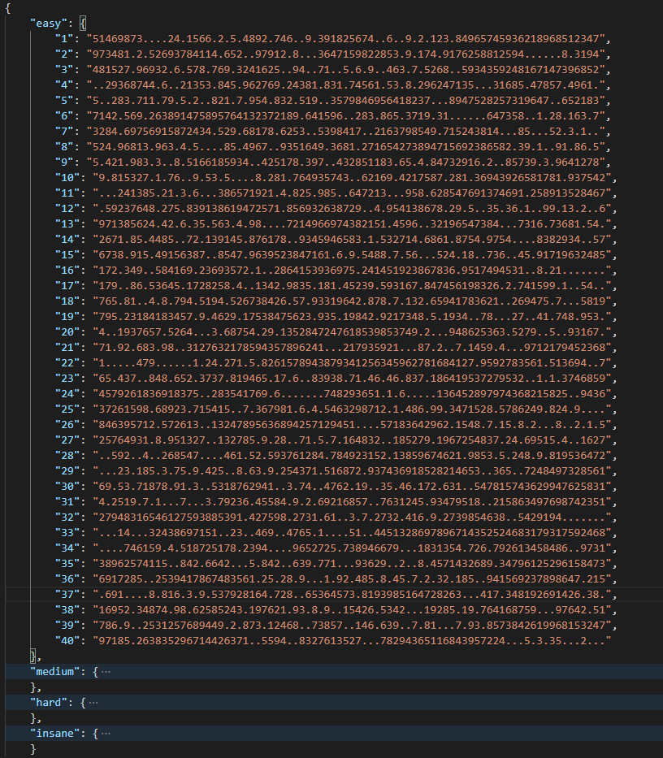
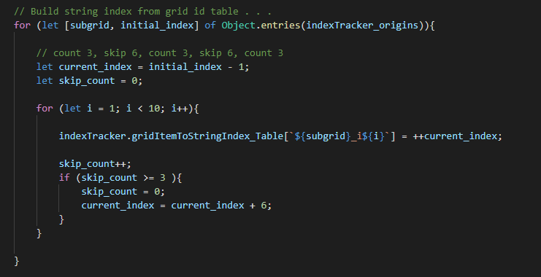
I precompiled 40 levels for each difficulty and stored them in a local JSON file
Each string represents a valid unsolved sudoku puzzle.
This string is later formatted to match the traditional grid layout

Slide 6
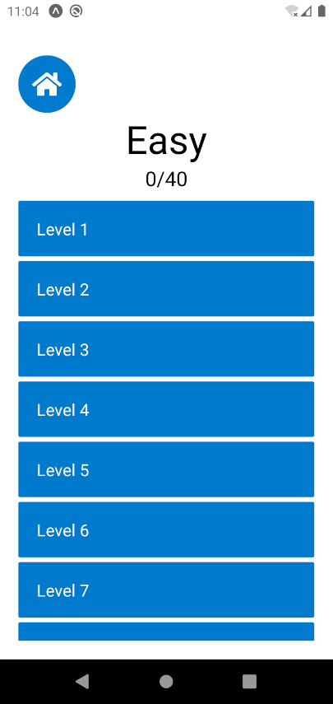
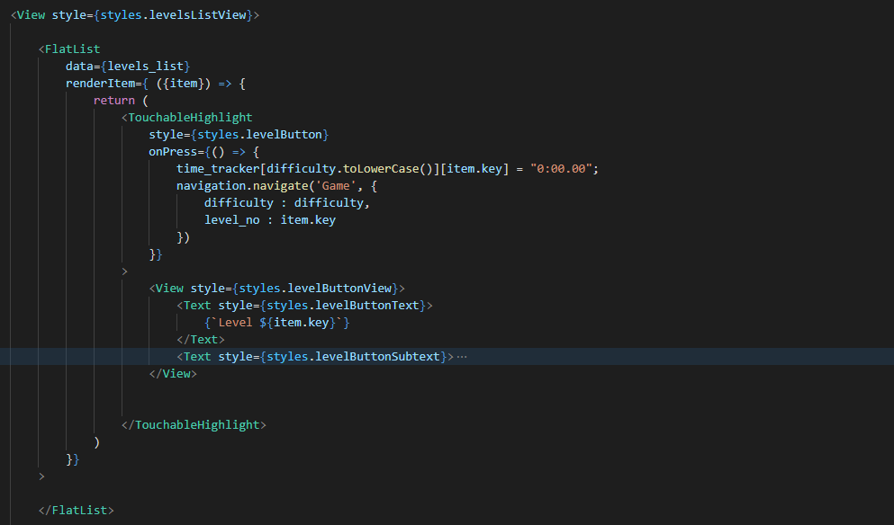
Level Selector
The number of levels for each difficulty are loaded from the JSON file, and also rendered dynamically using FlatList.

Slide 7
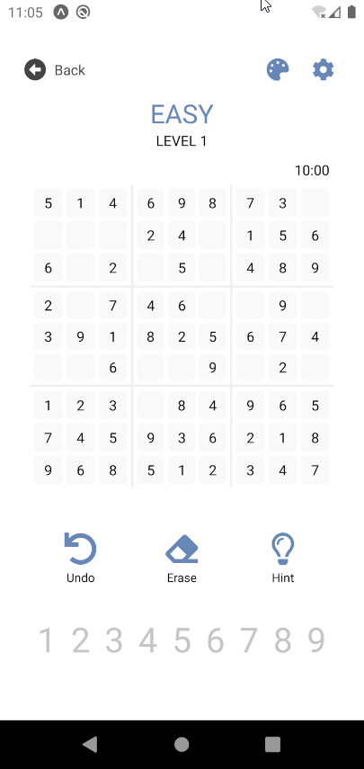
Game Page
The game page contained a top bar of buttons, the game grid, a row of image buttons, and a row of the number buttons.
The state of the difficulty and level number are remembered from the previous pages.
There is also a non-functional timer to track the player’s progress

Slide 8
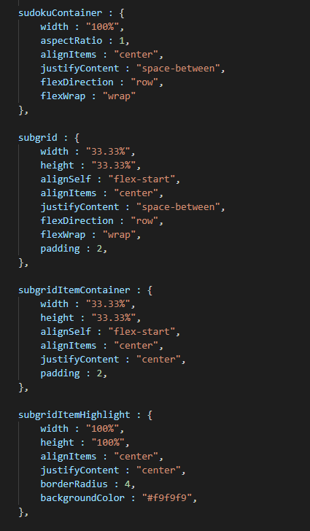
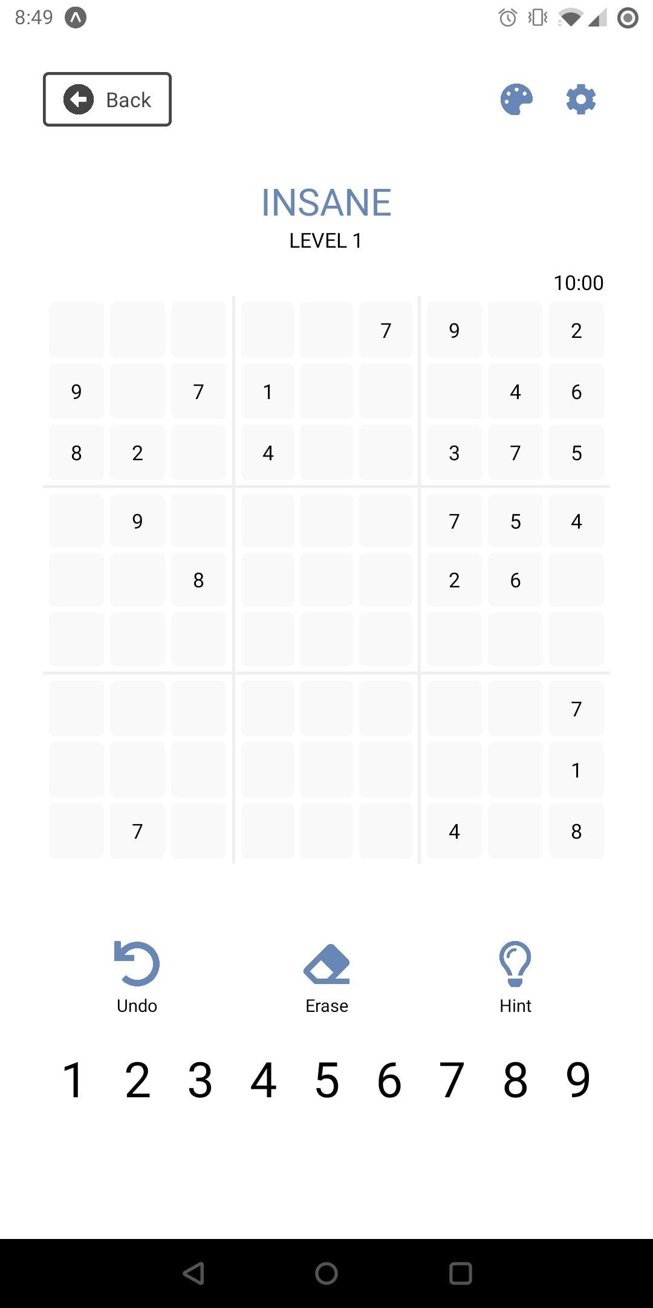
The game grid itself is very complex.
Each section was split off into 9 subgrid components. Each subgrid then contained 9 “item” cells.
Using percentage widths and heights and a combination of flex layouts and aligning, I was able to get a nicely centered grid.

Slide 9
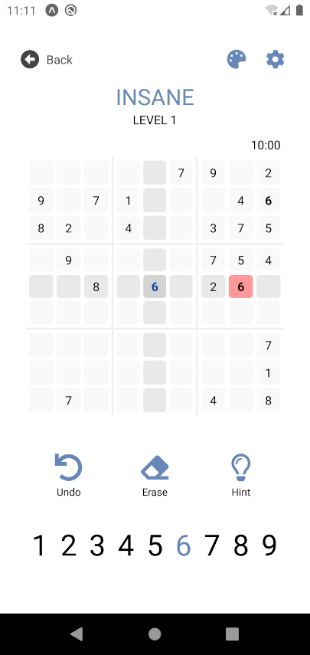
Featureset
Row/Column Highlighting
Duplicate numbers are highlighted
Current selected value is highlighted in the numbers bar
History tracking with a functional undo button
Erase feature
Hint feature that displays the correct value for one of the cells

Slide 10

Demo Video

Slide 11
Challenges
The game grid view was tough to implement as React Native does not have a simple Grid View like CSS on the web.
Because the sudoku games are 81 character long strings reading from left to right, I had write an ‘indexTracker’ to convert between string notation, grid-cell notation, and row/column notation.
React Native also does not support SVG images out of the box. I had to convert the icons to PNGs and recolor them manually.

Slide 12
Future Work
The ability to change “themes” (eg. colors, borders, fonts, etc.) would be an upcoming feature I look forward to adding.
Add functionality to the timer, so you can see how long it took to complete a puzzle.
Implementation of a “Random Challenge” to generate new random puzzles, if the player wants more than the pre-generated puzzles included.

Slide 13
fin
GitHub: https://github.com/DeveloperBlue/SudokuReactNative

Slide 14
References
https://github.com/robatron/sudoku.js/
https://reactjs.org/docs/hooks-state.html
https://reactjs.org/docs/hooks-effect.html
https://codehs.com/
https://en.wikipedia.org/wiki/Sudoku
https://reactnative.dev/docs/navigation

